Slide 1

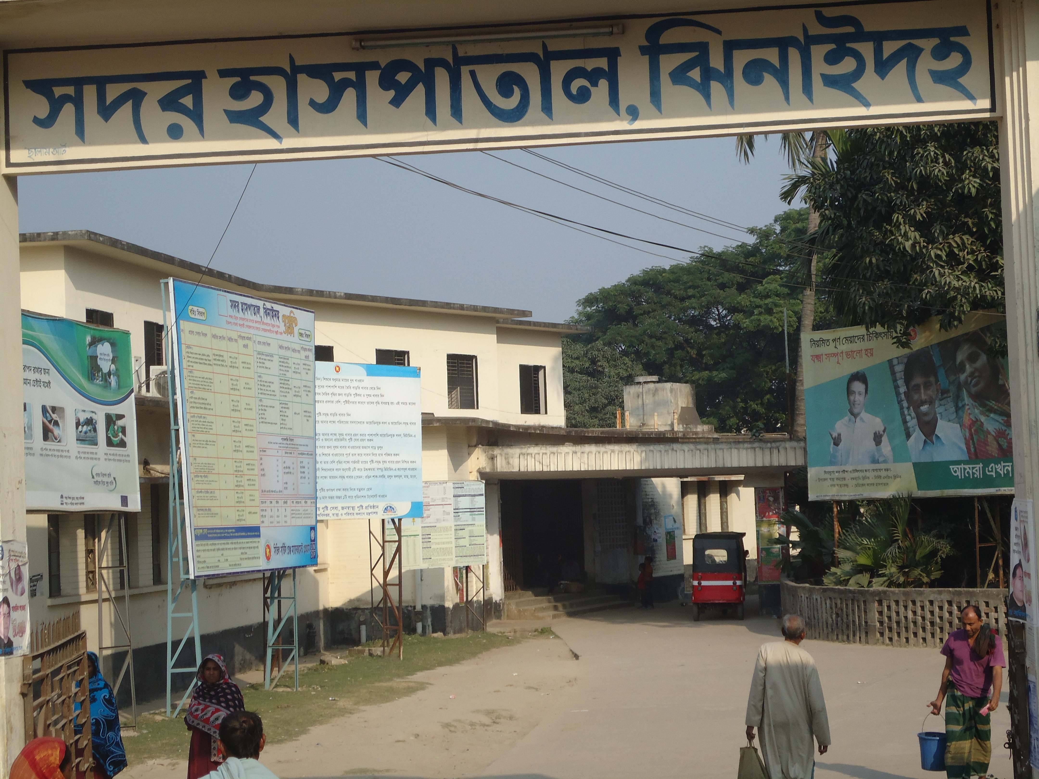
SADAR HOSPITAL, JHENAIDAH
Dr. Nasrin Sultana
Hospital Super,
Dr. Md. Emdadul Haque
Senior Consultant (Obs & Gynae)

Slide 2
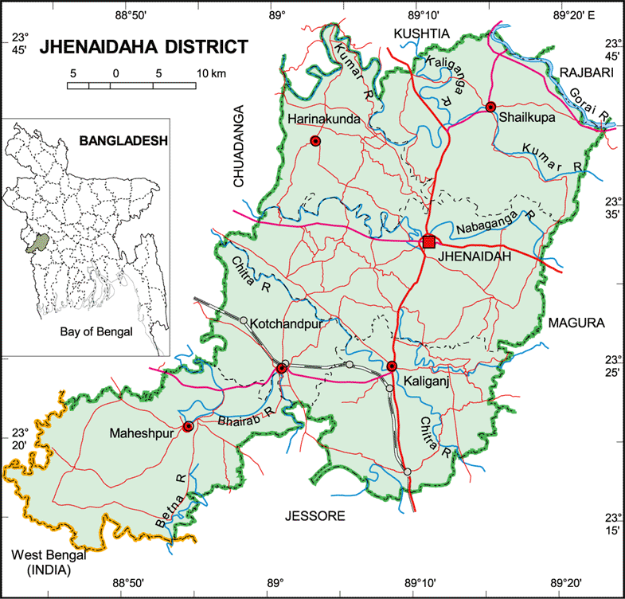

Slide 3
A District level Patient-Friendly Hospital with a Vision …
Maximum utilization of Govt.
resources with
honesty and sincerity
Integrated approach of
Administration, Community
Leaders & Health
Management
Providing Effective and
prompt services
through improved
management system
Show respect to the
patients
Develop as a model District
Hospital in Bangladesh

Slide 4
Health Profile of Jhenaidah District- 2011
Total Upazila : 06
Total Paurasava : 06
Total Union : 67
Total Village : 1271
Govt. Health Institution :
Sadar Hospital : 01
Total Health Complex : 05
Total H&FWC/ RD (57+13) : 70
Community Clinic : 167
NTC : 01
IHT : 01
MCWC : 01
MATS : 01
Sishu Hospital : 01
ORS Preparation Plant : 01
Non-Govt. Health Institution :
Diabetic Hospital : 01
Eye Hospital : 01
Non-Govt. Clinic (Redg.) : 114

Slide 5
Health Profile of Jhenaidah District- 2011
Total population : 1857149
Total Pregnant : 38074
Total Live birth : 36926
Total Under five children : 200769
As per National data
Total Death : 11142 (D.R 6.1/1000 pop)
Total Maternal Death : 72 (MMR 194/100000 LB)
Total Parental Death : 1903 (PNDR 50/1000 Del)
Total Neonatal Death : 1366 (NNDR 37/1000 LB)
Total Infant Death : 1920 (IMR 52/1000 LB)
Total Under five Death : 2400 (U5MR 65/1000 LB)

Slide 6
Human resources of Jhenaidah Sadar Hospital-2012
(100 Beded ( 50 Beded )
Post Post Vacant
a) Doctors 42 22 2
Super 01 0 0
Consultant (11+10) 21 10 2
MO 20 12 0
b) Nurse 38 42 2
Super 01 0 0
Supervisor 02 02 0
SSN/ JN (35+0) 35 (35+5) 40 2
c) 2nd & 3rd Class 30 20 3
Office Staff 08 04 0
MT +Pharma (6+3) 09 (3+3) 06 1
Others 13 10 0
d) 4th Class 40 24 0
Aya+Ward Boy (3+5) 08 0 0
MLSS+ Cleaner (5+8) 13 (10+7) 17 0
Guard 05 0 0
Cook 04 03 0
Others 14 04 0
Total Manpower 150 105 5
e) Non Govt Aya+ Cleaner+ Guard 38 0

Slide 7
Background History of Jhenaidah Sadar Hospital
Foundation stone of Jhenaidah Sadar Hospital was established in 1968 as Sub-Division Hospital in Eleven acre area at Hamdah. The hospital become functioning from December 1970.
- From February 1984 recognized as District Sadar Hospital.
- In 1994 upgrade to 100 Bedded Hospital without manpower & infrastructure.
- In June 2000 Spinal Anesthesia used in operation.
- In May 2005 infrastructure of 100 beded hospital completed.
- In September 2006 C.C.U infrastructure completed without manpower.
- In 2006 EOC ward become functioning.
- In 2007 Laparoscopic surgery used in Hospital.
- In February 2010 NTC become functioning by admission of 31 nurse student.
- In 2010 the Hospital is awarded for EOC Activities for its best performance in
Khulna Division among the District Hospital.
- In September 2012 Honorable Health & Family Welfare Minister visited Jhenaidah
Sadar Hospital and satisfied for hospital activities.

Slide 8
Sadar Hospital, Jhenidah
Health, populaton and Nutrition Targets for the SFYP -1
Sl | Indicators | Base value with year | FY 2015
 | Impact / Outcome
1. | Life Expectancy | 66.6 ( SVRS 2007) | 70
2. | Population Growth Rate | 1.40 ( SVRS 2007) | 1.3
3. | Maternal mortality Ratio (MMR ) per 100000 live births | 194 ( BMMS2010) | 143
4. | Neonatal Mortality Rate ( per 1000 live births) | 37 ( BDHS 2007 | 27
5. | Infant Mortality Rate ( per 1000 live births ) | 52 ( BDHS 2007) | 31
6. | Under 5 mortality Rate ( per 1000 live births) | 65( BDHS 2007) | 50
7. | Malaria mortality ( per 100000 population ) | 4.4 | 2.2
8. | Maintain low prevalence of HIV | <1% | <1%
9. | Prevalence of Night blindness among pregnant women | 2.90% | 1%
10. | Underweight of Under 5 children 16-59 months ) | 41%( BDHS 2007) | 33%
11. | Stunting of under 5 children (16-59 months) | 43%( BDHS 2007) | 25%
12. | Total fertility rate ( TFR) | 2.7( BDHS 2007) | 2.2

Slide 9
Sadar Hospital, Jhenidah
Health, populaton and Nutrition Targets for the SFYP -2
Sl | Indicators | Base value with year | FY 2015
 | Output
13. | Contaceptive prevalence Rate ( CRP ) | 55% ( BDHS 2007) | 74%
14. | Permanent & Long acting FP ( of CPR ) | 7.3% ( BDHS 2007) | 20%
15. | TB case detection rate | 73% (NTP 2008) | 75%
16. | TB cure rate from | 92% ( NTP 2008) | 95%
17. | Births attended by skilled health personnel | 26.5% ( UESD 2010) | 50%
18. | Facility level delivery | 15% ( BDHS 2007) | 40%
19. | ANC coverage ( 4 visits ) | 20.6% ( BDHS 2007) | 50%
20. | PNC coverage ( Mother ) | 21.3( BDHS 2007) | 50%
21. | PNC coverage ( children ) | 21.9% ( BDHS 2007) | 50%
22. | Met need for EOC services | 22.43% ( BDHS 2007) | 80%
23. | TT coverage ( Children Protected at birth from tetanus ) | 93%(CES 2008) | 95%
24. | Valid coverage of full immunized children | 75.2% (CES 2008) | 90%
25 | Immunization of 1 year old children against Measles | 83%(CES.2008) | 90%
26 | VAC coverage ( 6m -6y) | 98%-100% | 98%-100%
27 | Postnatal VAC supplementation | 29% | 80%
28 | Severe anemia ( Children ) | 64% | 50%
29 | Severe anemia ( Pregnant women ) | 46% | 40%
30 | Exclusive breast feeding of children ( less than 6 months) | 42% | 80%

Slide 10
Sadar Hospital, Jhenidah
Emergency, Out door & Indoor Service 1998 to 2012
Sl No | Year | Emergency Patients | Out door Service | indoor Service | Bed occupancy rate
01 | 1998 | 16733 | 65062 | 12973 | 126%
02 | 2009 | 23116 | 136464 | 19623 | 137%
03 | 2010 | 25868 | 123764 | 20384 | 136%
04 | 2011 | 28855 | 141999 | 22435 | 146%
05 | 2012 | 30001 | 141069 | 22951 | 143%

Slide 11
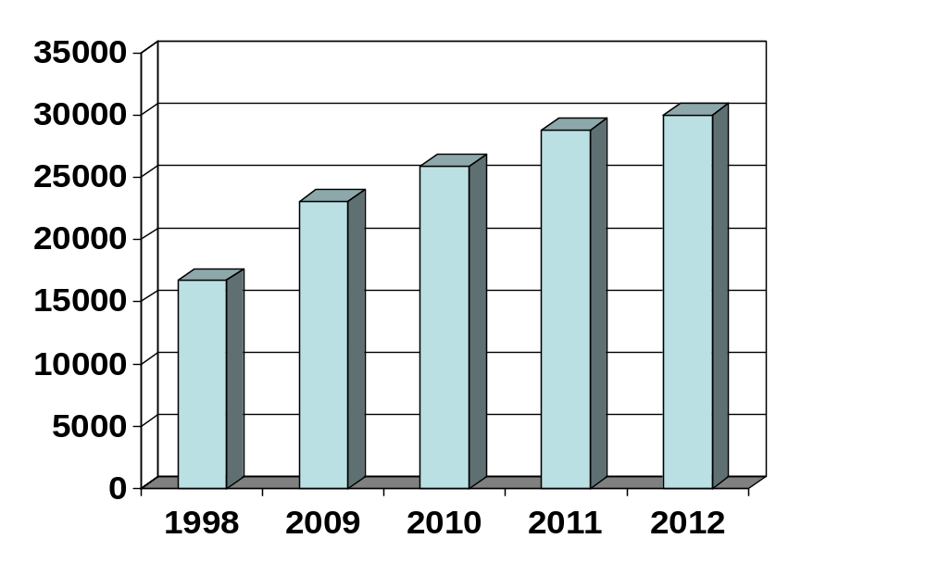
Emergency Patients
28855
30001
25868
23116
16733

Slide 12
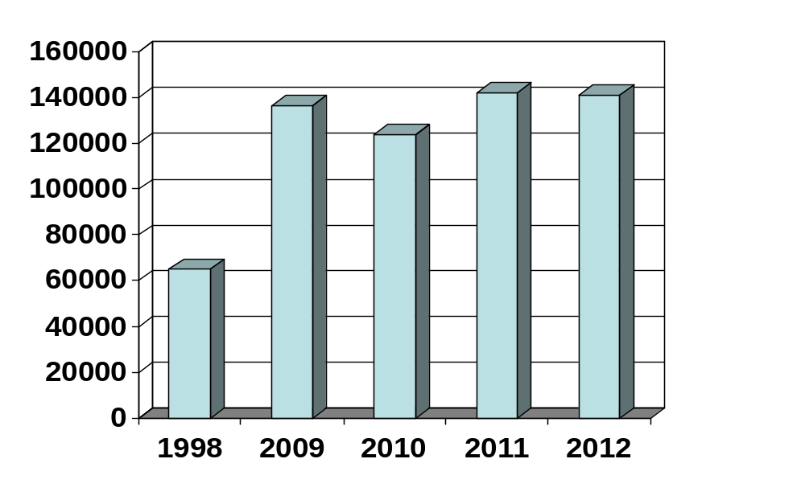
Out door Service
136464
141999
141069
123764
65065

Slide 13
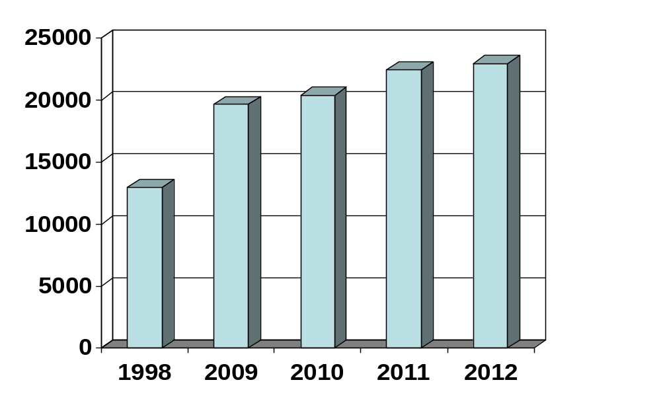
Indoor Service
22435
22951
19623
20384
12973

Slide 14
Sadar Hospital, Jhenidah
EOC Service 1998 to 2012
Sl No | Year | ANC Services | Admitted Patient | Complications | Type of Delivery |  |  |  | PNC | Maternal Death
 |  |  |  |  | NVD | ASST DEL | CS | Total
01 | 1998 | 257 | 1364 | 542 | 951 | - | 155 | 1106 | - | 18
02 | 2009 | 434 | 3264 | 1374 | 1673 | 42 | 539 | 2254 | 2302 | 05
03 | 2010 | 1099 | 3514 | 1317 | 1778 | 32 | 546 | 2356 | 2256 | 4
04 | 2011 | 1354 | 3906 | 1191 | 1912 | 33 | 430 | 2375 | 2140 | 1
05 | 2012 | 2268 | 4261 | 1934 | 1784 | 44 | 551 | 2379 | 2467 | 3

Slide 15
Sadar Hospital, Jhenidah
Comparative Data of EOC services in April,2012 & April,2013 at Jhenaidah Sadar Hospital
SL No. | Indicators | April,2012 | April,2013
1. | Admission | 275 | 437
2. | Total delivery | 170 | 201
3. | C. Section | 34 | 84
4. | ANC service | 55 | 514
5. | PNC service | 170 | 281

Slide 16
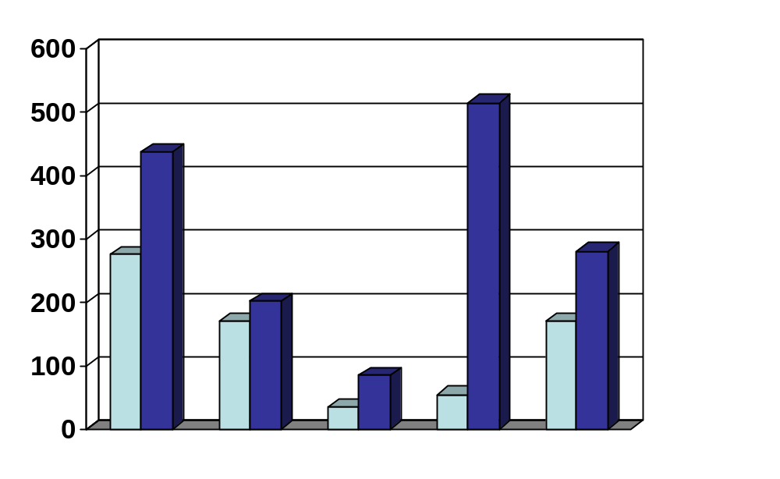
Sadar Hospital, Jhenidah
Comparative Data of EOC services in April,2012 & April,2013 at Jhenaidah Sadar Hospital
514
437
275
281
201
170
170
84
55
34
Admission
Total delivery
C. Section
ANC
PNC

Slide 17
Sadar Hospital, Jhenidah
Comparative Data of Delivery of best performing EOC center of Khulna Division in 2011
SL No | Name of institute | NVD | Vacuum Del. | V. Breech | C. Section | Total
01. | Chowgacha UHC | 3346 | 34 | 26 | 1007 | 4413
02. | Ad-din Hospital Jessore. | 1124 | 0 | 0 | 1864 | 3492
03. | Khulna Medical College Hospital | 1581 | 58 | 18 | 1356 | 3013
04. | 250 bed Hospital, Jessore | 1327 | 2 | 25 | 1498 | 2852
05. | 250 bed Hospital, Khustia | 1728 | 0 | 34 | 915 | 2677
06. | Jhenidah Sador Hospital | 1912 | 0 | 33 | 430 | 2375
07. | Fatima Hospital Jessore. | 519 | 0 | 6 | 1061 | 1586

Slide 18
Sadar Hospital, Jhenidah
Development in EOC Service in Jhenidah.
Introduce Labour Admission Register, Labour Ward Admission Form, Separate Discharge Form.
All EOC Related Patient kept in a ward.
Starting of ANC & PNC corner and Arrange a Room for Medical Officer.
NO. of EOC Bed increase from 10 to 21 though on EOC bed only 5.
Improve EOC Operation Theater.
Shifting of Labour room & arrange pre-labour room with three beds & maintenance of privacy.
Moral based environment with 7 (seven) workers supported by community donors.
Make a breast feeding corner & Provision of Vitamin A distribution for PNC Mother.
Starting of Health education system.
Set up of dropler machine & Ventouse Machince.
EOC Operation activities extended from 8 A.M. to 2 P.M to 8 P.M.
Ensuring Rational use of drugs in EOC ward.
Provision of Mobile Phone in EOC ward no. 01742732116.
Improvement of Eclumpsia room.
Provision of Emergency kit boxes such as PPH kit, Eclumpsia kit.
Shoe-free environment for infection control.
The center is used as a effective training center for SBA, Nursing student, Mid-wifiry.

Slide 19
Sadar Hospital, Jhenidah
Operation Service 1998 to 2012
Sl No | Year | Major | Minor | Total
01 | * 1998 | - | - | 1089
02 | 2009 | 891 | 3099 | 3980
03 | 2010 | 842 | 3276 | 4127
04 | 2011 | 780 | 4857 | 5629
05 | 2012 | 977 | 5433 | 6410
* There was no Anesthesiologist in 1998

Slide 20
Sadar Hospital, Jhenidah
Blood Transfusion Service 1998 to 2012
Sl No | Year | No. of Bag
01 | 1998 | 661
02 | 2009 | 2186
03 | 2010 | 1985
04 | 2011 | 1423
05 | 2012 | 1360

Slide 21
Sadar Hospital, Jhenidah
Medico Legal Case 1998 to 2012
Sl No | Year | Physical Assault | Post Mortem | Suicidal
 |  |  |  | Poisoning | Hanging | Total
01 | 1998 | 1379 | 487 | - | - | 370
02 | 2009 | 1650 | 142 | 683 | 45 | 728
03 | 2010 | 1527 | 115 | 747 | 66 | 813
04 | 2011 | 1721 | 110 | 873 | 58 | 931
05 | 2012 | 1458 | 119 | 753 | 65 | 818

Slide 22
Sadar Hospital, Jhenidah
No. of Patient’s Death 1998 to 2012
Sl No | Year | No. of Death
01 | 1998 | 541
02 | 2009 | 446
03 | 2010 | 247
04 | 2011 | 403
05 | 2012 | 296

Slide 23
Problems of Sadar Hospital-1
100 Beded Hospital running with 50 beded manpower since 1994.
There are 9 unit in hospital (wards 06, OT, Out door, Emergency) needs cleaners about 36 but there are only 7 cleaners.
There is no post of Aya, Ward boy, Security guard in the Hospital.
There is no post of indoor medical officer so hamper indoor service & night rounds.
One (01) anesthesiologist working for surgery, gynae, Orthopedics, ENT, Eye, 24 hours EOC & emergency service.
There is no effective waste management system.
Condemnation board is not working regularly due to administrative problems.
Many of the instruments and equipments are not functioning due to lack of bio-technologist & funds for repair.
There is no target for indoor-outdoor patient & huge number of indoor & out door patient creates a heavy loads for services providers .
MIS system is weak and there is no hospital action plan.
No client satisfaction survey system.
The number of nurses is very few.
Hospital health management committee & monthly co-ordination committee meeting is not perform regularly.
Female privacy is not properly maintained.
Insufficient in toilets & safe drinking water supply.
Influential person influence on tenders of drugs, free cabin & paying ward.
Auditing & accounting system is not corruption free.
Consultants & MOs are also the teacher of NTC, MATS etc. which affect hospital services.
Three doctors are illegally suspended.

Slide 24
Problems of Sadar Hospital-2
There is no visitor control system .
EPI, ORT corner, DOTS corner, VIA centre are running with least or no defined health personnel.
Health education systems is very poor .
There is no pediatrician in this Hospital.
There are 5 beds in EOC word, which is insufficient for 40000 pregnant mother per year in Jhenidah District .
There is no intercom system .
There is no IMCI corner for under 5 children .
Non health Issues get less importance.
Scarcity of blood in emergency need.
There is no adolescence health corner.

Slide 25
Sadar Hospital, Jhenidah
Community Support System in Sadar Hospital
Eighteen (18) man power (2000 Tk per month per person) is supported by Dr. Abdur Rahman (Anesthesiologist), Dr. Nasrin Sultana (Civil Surgeon ), Dr. Md. Emdadul Haque( Senior Consultant, Gynae & Obs), Dr. AKM Kamal (Cardiologist), Dr. Rased Al Mamun, Social Welfare Deptt. of Drug International Pharmaceutical ,Dr Sk Abul.Fattah (associate professor of medicine), Mr. Nasser Shahrear Zahedee (Muhul), Chairman of Zahedee foundation, Mr. Konok Kanti Dash (Upazilla Chairman), Mr. Kahorsedul Alom Zinna.
Mayor of Jhenidah Powrshova Mr. Saydul Karim Mintu plays a major role in cleanness of the outer environment of the Hospital. Completed the broken boundary wall of the hospital and made 4 dustbin and repair the broken glass of the windows of female surgery ward, female paying ward and female medicine ward with a cost of nearly one lac taka.
Chairman of Zahedee foundation donates four man power support and an intercom system for the hospital with a cost of nearly two lac taka.
EMOs of the Hospital repair their broken windows by self donation.
Mr Khandaker Faroquazaman (Farid) UP Chairman, Harishonkorpur, Jhenidah repairs 3 benches for seating of EOC outdoor patient.
Voluntary blood donors donates blood regularly .
Some of the Pharmaceuticals helps in forms and discharge certificate and seating arrangement
Mr. Shorahb Hossain (Sabu), Mr. Johir Raihan helps in butification and wall writing of EOC ward.

Slide 26

Thank you

